Slide 1
UNSUPERVISED MACHINE LEARNING ALGORITHMS FOR EDGE NOVELTY DETECTION
Prof. Marcello CHIABERGE
Dott. Umberto ALBERTIN
Dott. Gianluca DARA
Ariel Priarone

Slide 2
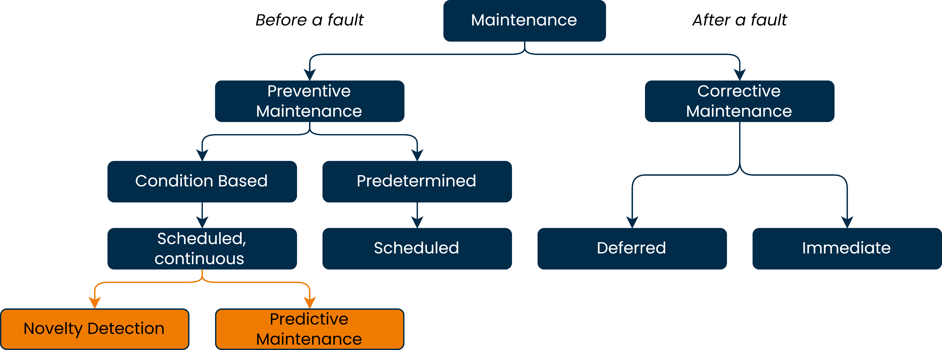
Overview about maintenance

Slide 3
Overview about maintenance

Slide 4
Overview about maintenance

Slide 5
MotivatioN
Efficiency
establishments relying on reactive maintenance are associated with 3.3x more downtime compared to establishments relying on preventive maintenance
Less downtime

Slide 6
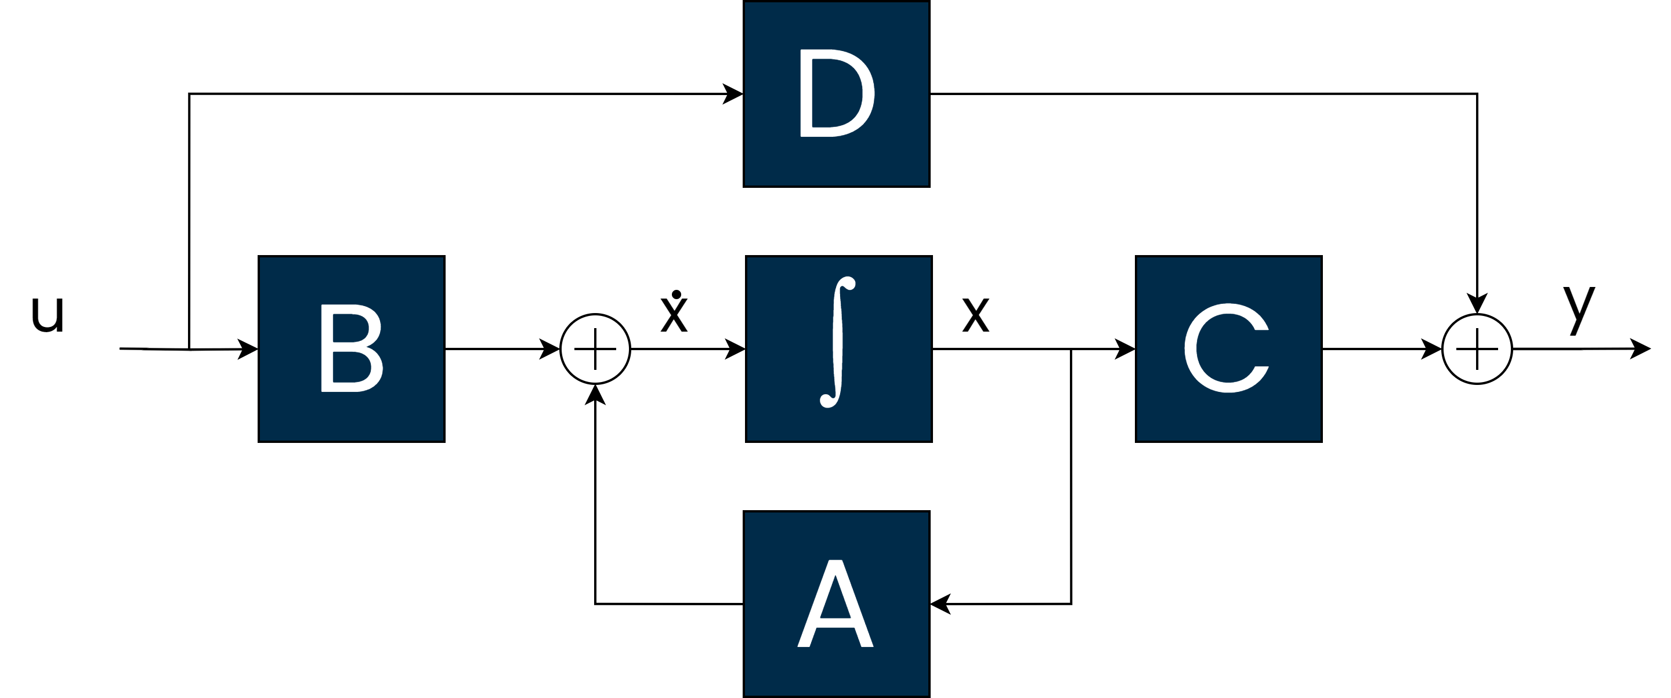
Motivation
Efficiency
establishments relying on reactive maintenance are associated with 3.3x more downtime compared to establishments relying on preventive maintenance
Model not available
Knowledge
The physical model of the maintained system is not available
There is no data-driven knowledge about the failures of the device
Less downtime

Slide 7
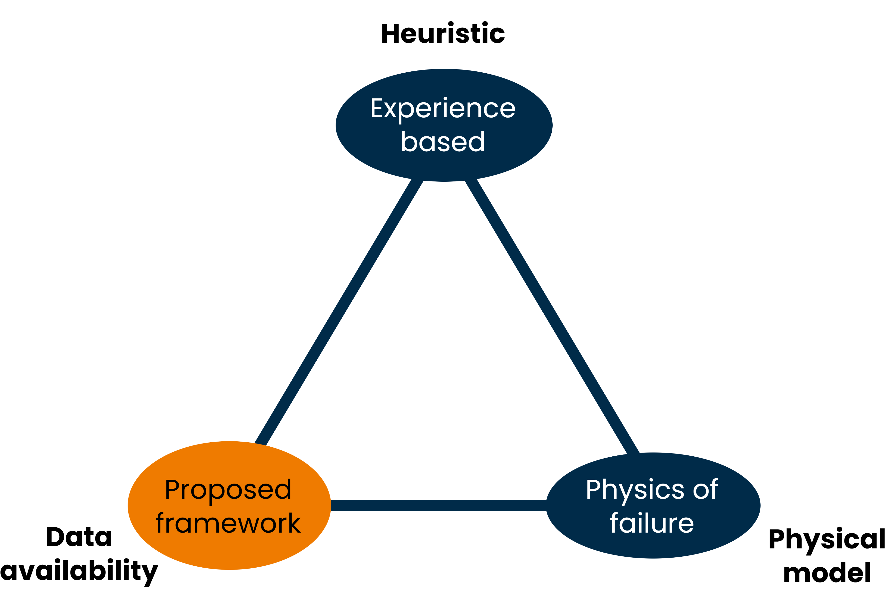
Objective
The developed framework:
Data-driven
Collects the training dataset
Trains a UML model
Provides a Novelty Metric
Estimates the RUL
General purpose
Modular

Slide 8
Objective
The developed framework:
Data-driven
Collects the training data
Trains a UML model
Provides a Novelty Metric
Estimates the RUL
General purpose
Modular

Slide 9
Objective
The developed framework:
Data-driven
Collects the training data
Trains a UML model
Provides a Novelty Metric
Estimates the RUL
General purpose
Modular

Slide 10
Objective
The developed framework:
Data-driven
Collects the training data
Trains a UML model
Provides a Novelty Metric
Estimates the RUL
General purpose
Modular

Slide 11
Objective
The developed framework:
Data-driven
Collects the training data
Trains a UML model
Provides a Novelty Metric
Estimates the RUL
General purpose
Modular

Slide 12
Objective
The developed framework:
Data-driven
Collects the training data
Trains a UML model
Provides a Novelty Metric
Predicts the RUL
General purpose
Modular

Slide 13
Objective
The developed framework:
Data-driven
Collects the training data
Trains a UML model
Provides a Novelty Metric
Predicts the RUL
General purpose
Modular

Slide 14
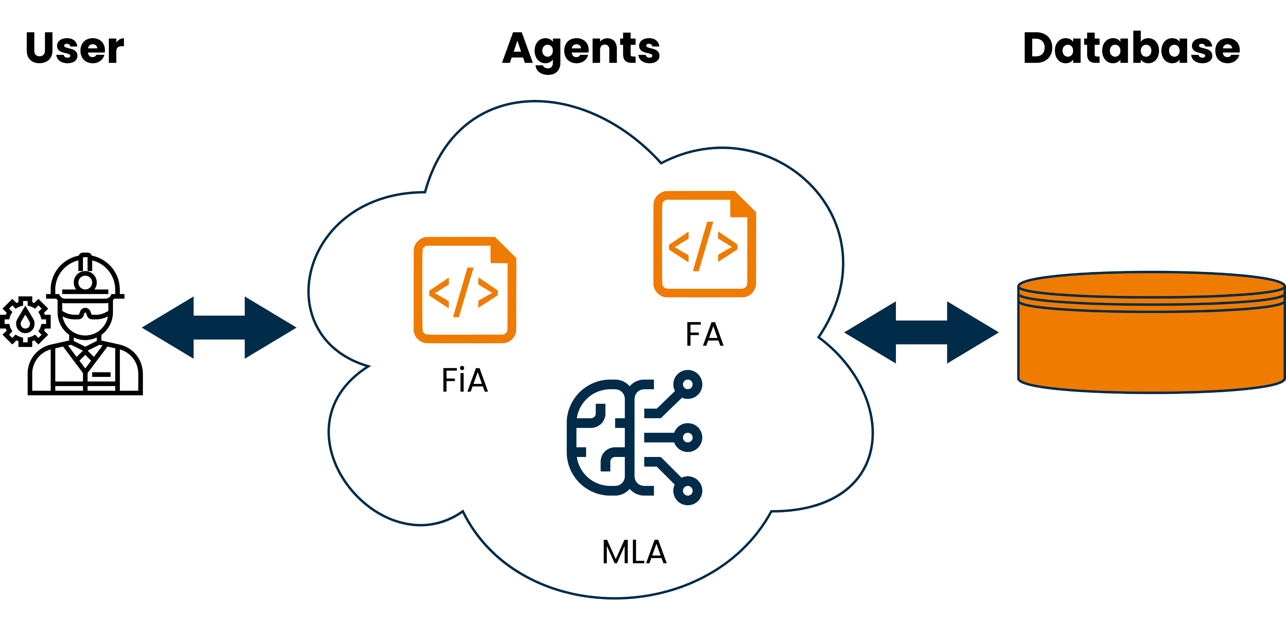
Framework Structure

Slide 15
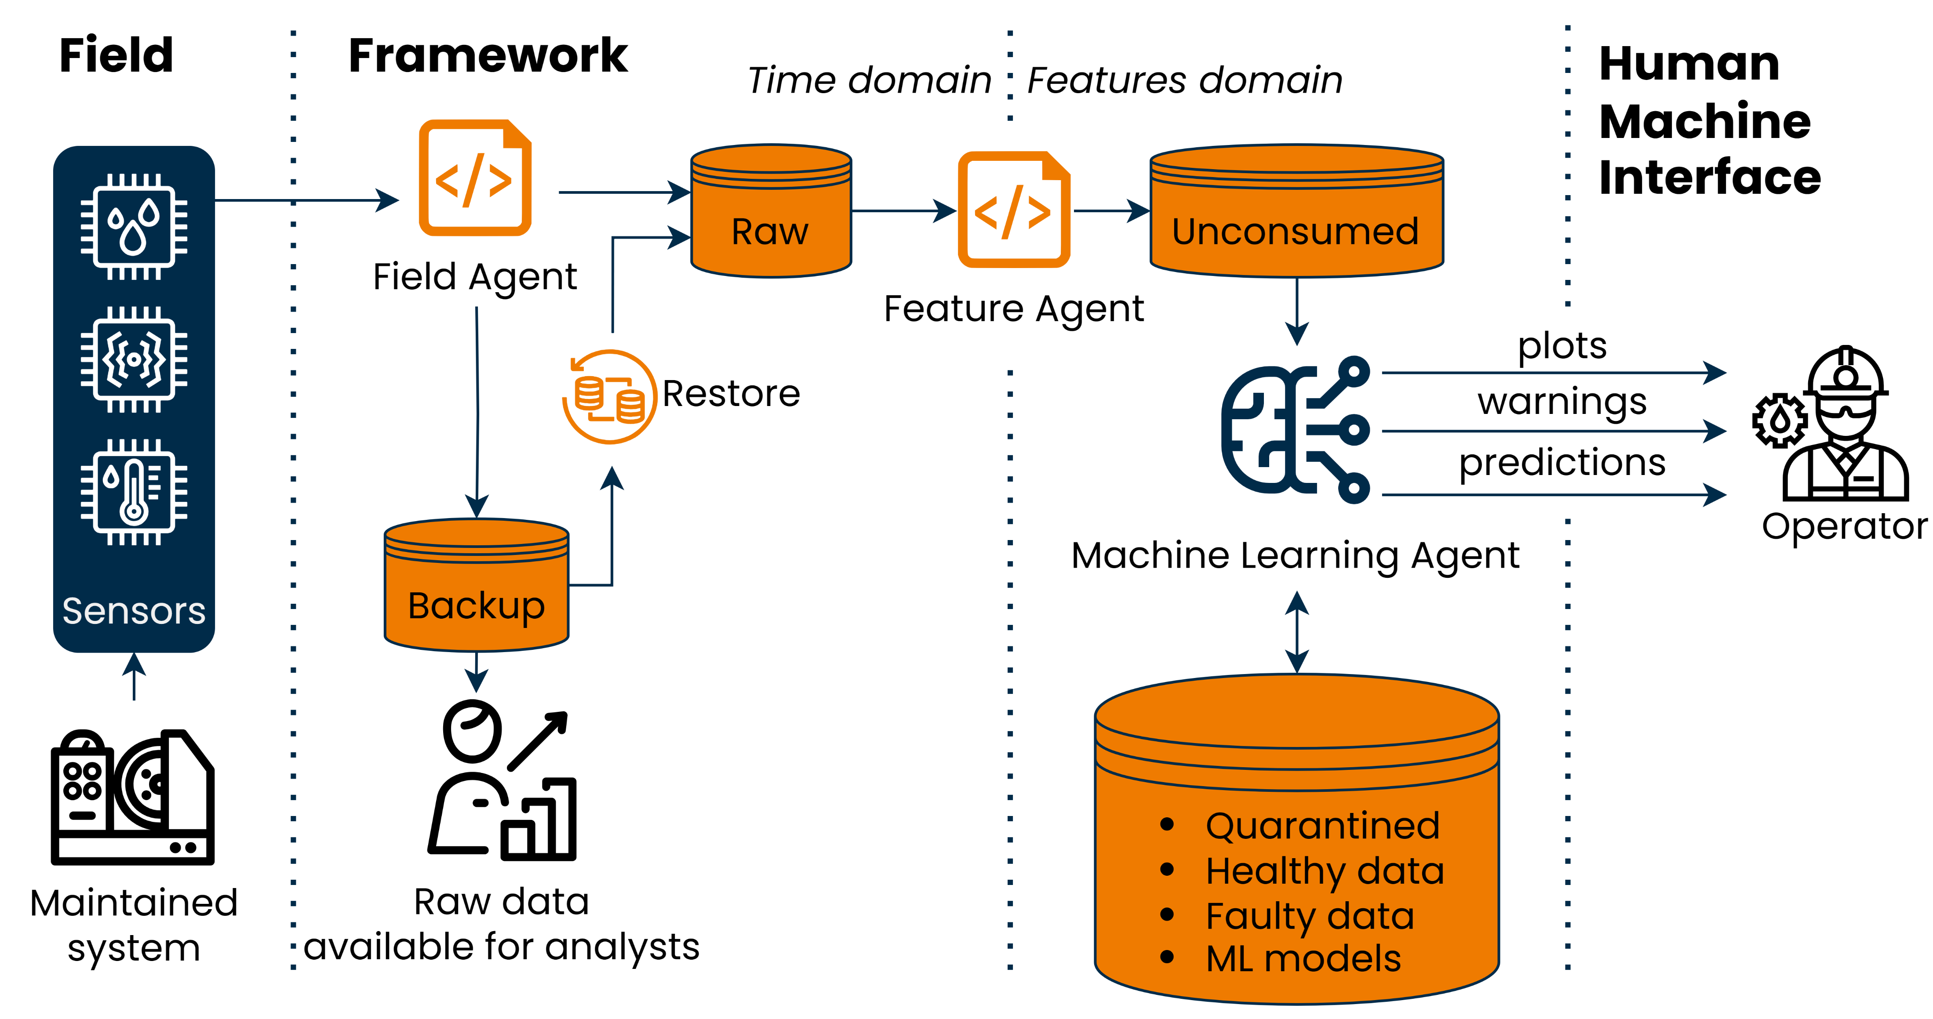
Framework Structure

Slide 16
Framework Structure

Slide 17
Framework Structure

Slide 18
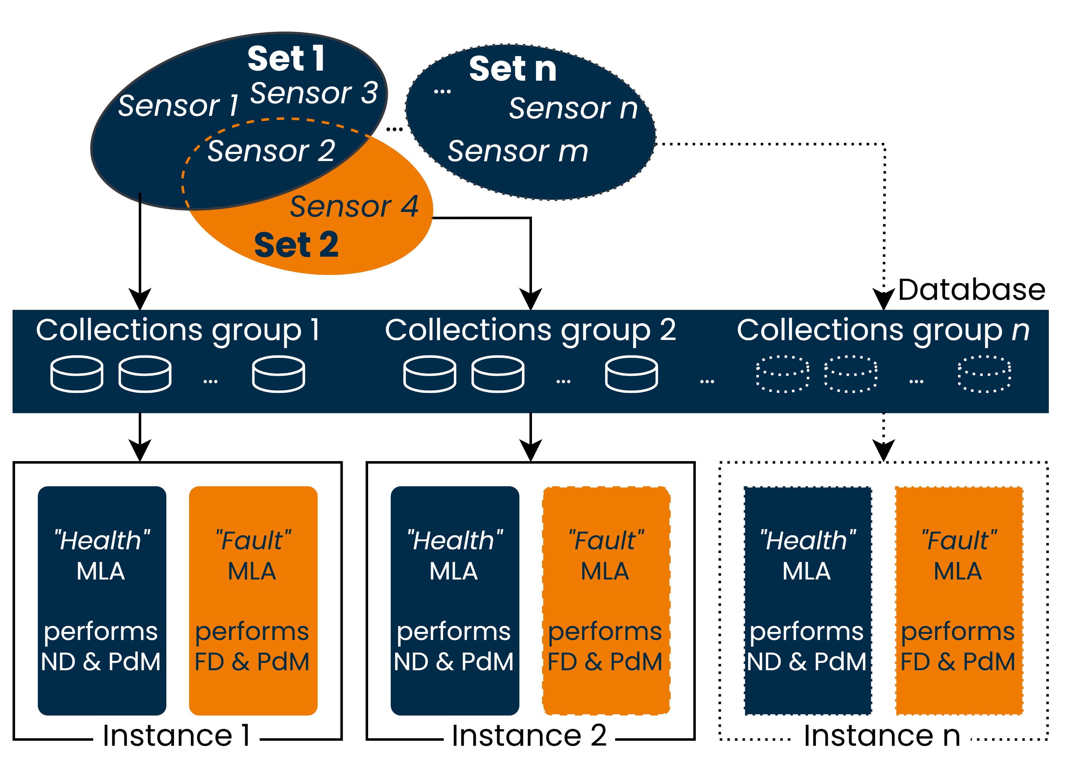
Multiple instances

Slide 19
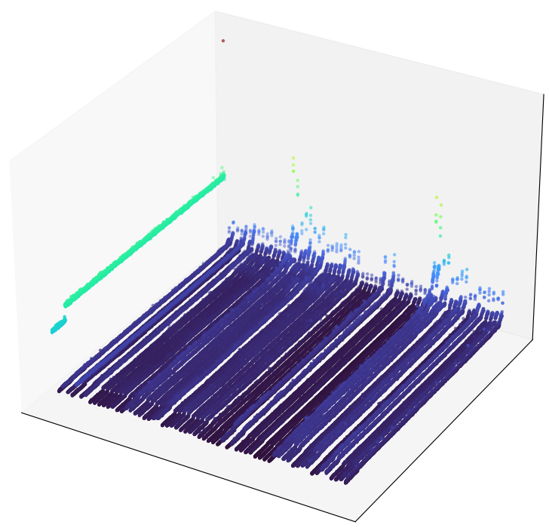
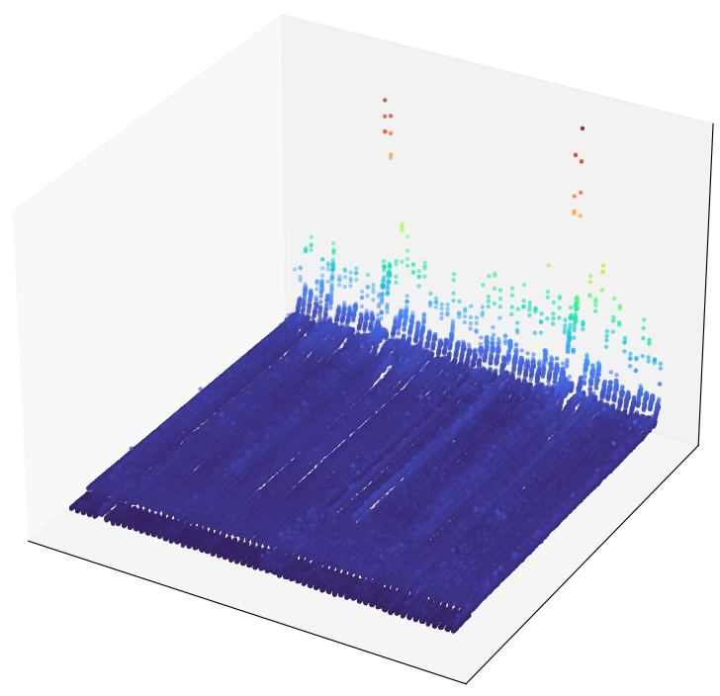
FEATURES EXTRACTION
Time domain
Mean
Standard deviation
Peak-to-peak (P2P)
Root Mean Square (RMS)
Skewness
Kurtosis
Standardization
Values
Samples
Frequency domain
Features
Values
Fast Fourier Transform (FFT)
Wavelet Packet Decomposition (WPD)
Samples
Features

Slide 20
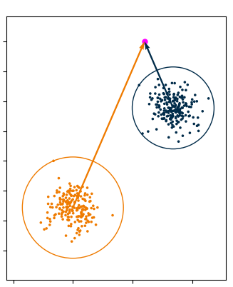
Validation On Vibration dataset
Feature j
Results of Novelty Detection on a bearing vibrations dataset
Feature j

Slide 21
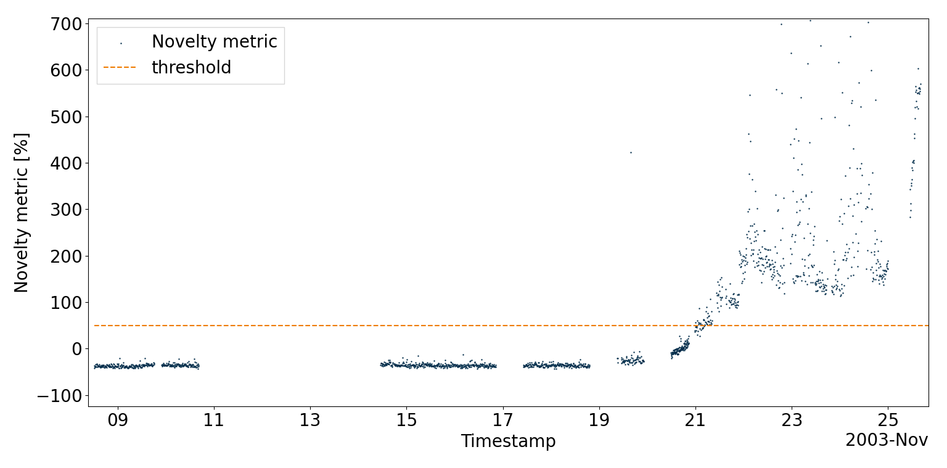

Novelty Detection
Novelty warning issued

Slide 22
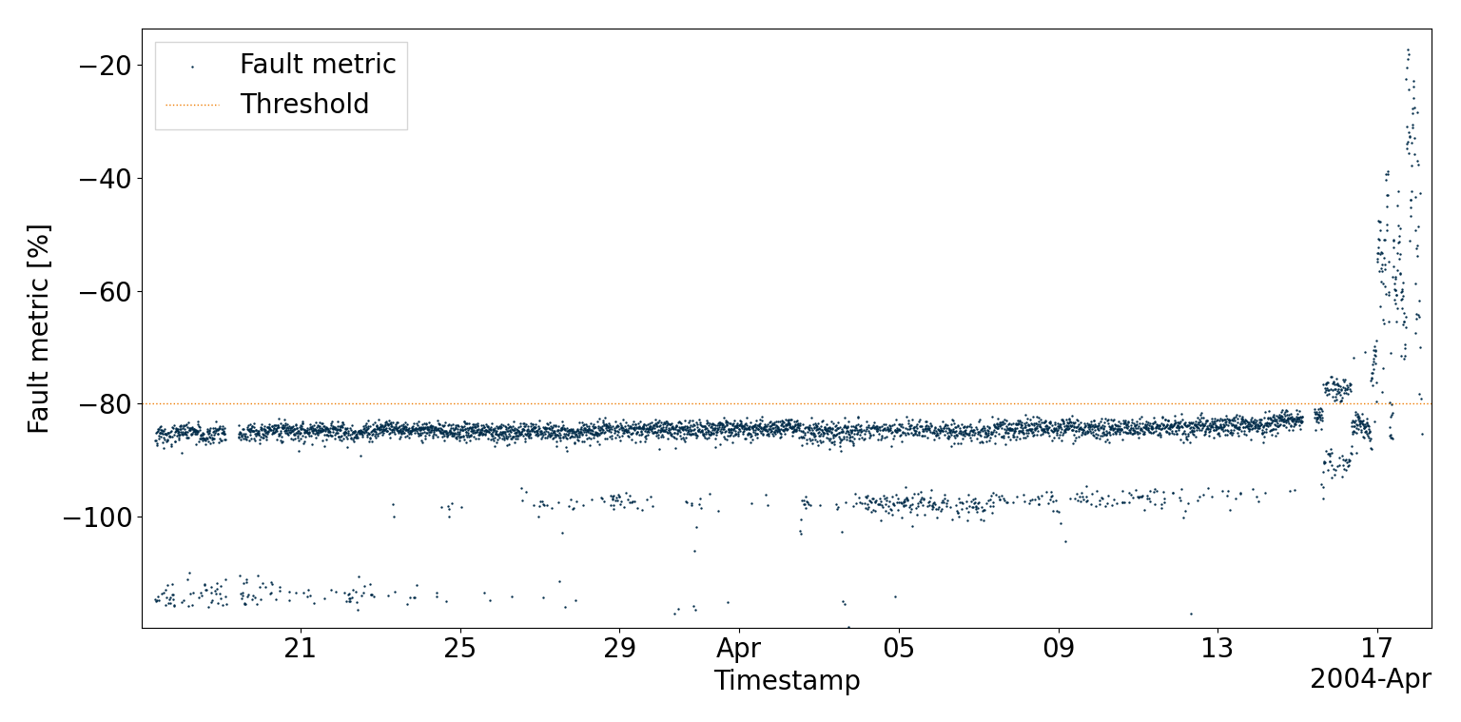
Fault Detection
Fault warning issued

Slide 23
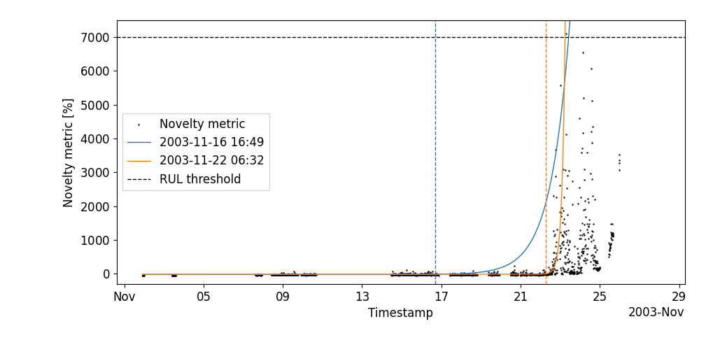
Predictions

Slide 24
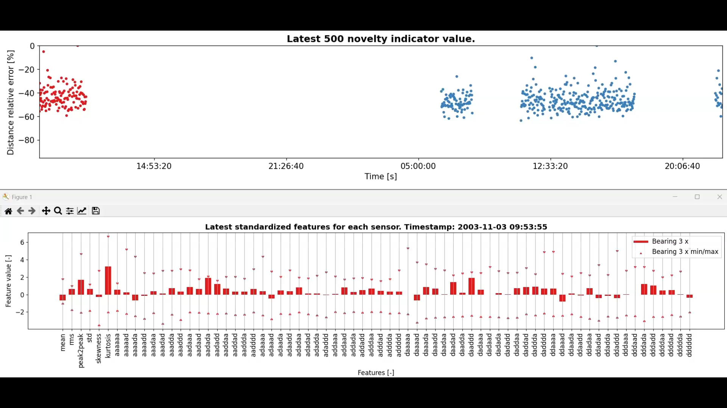
Real-time evaluation – Normal condition

Slide 25
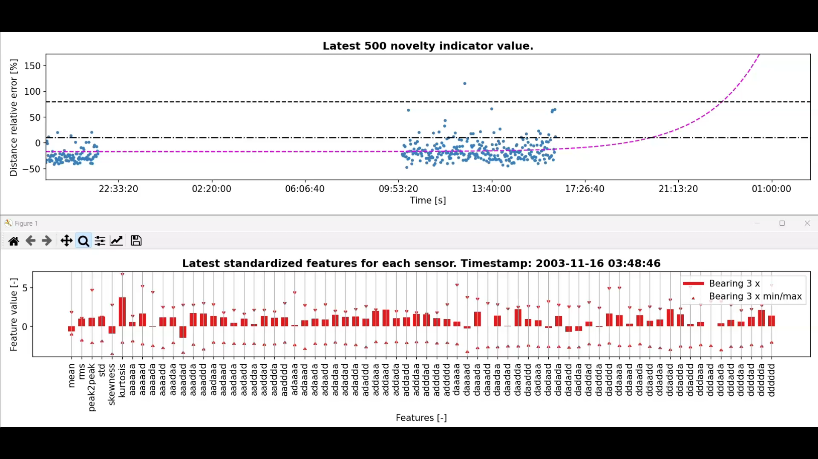
Real-time evaluation – Fault Condiiton

Slide 26
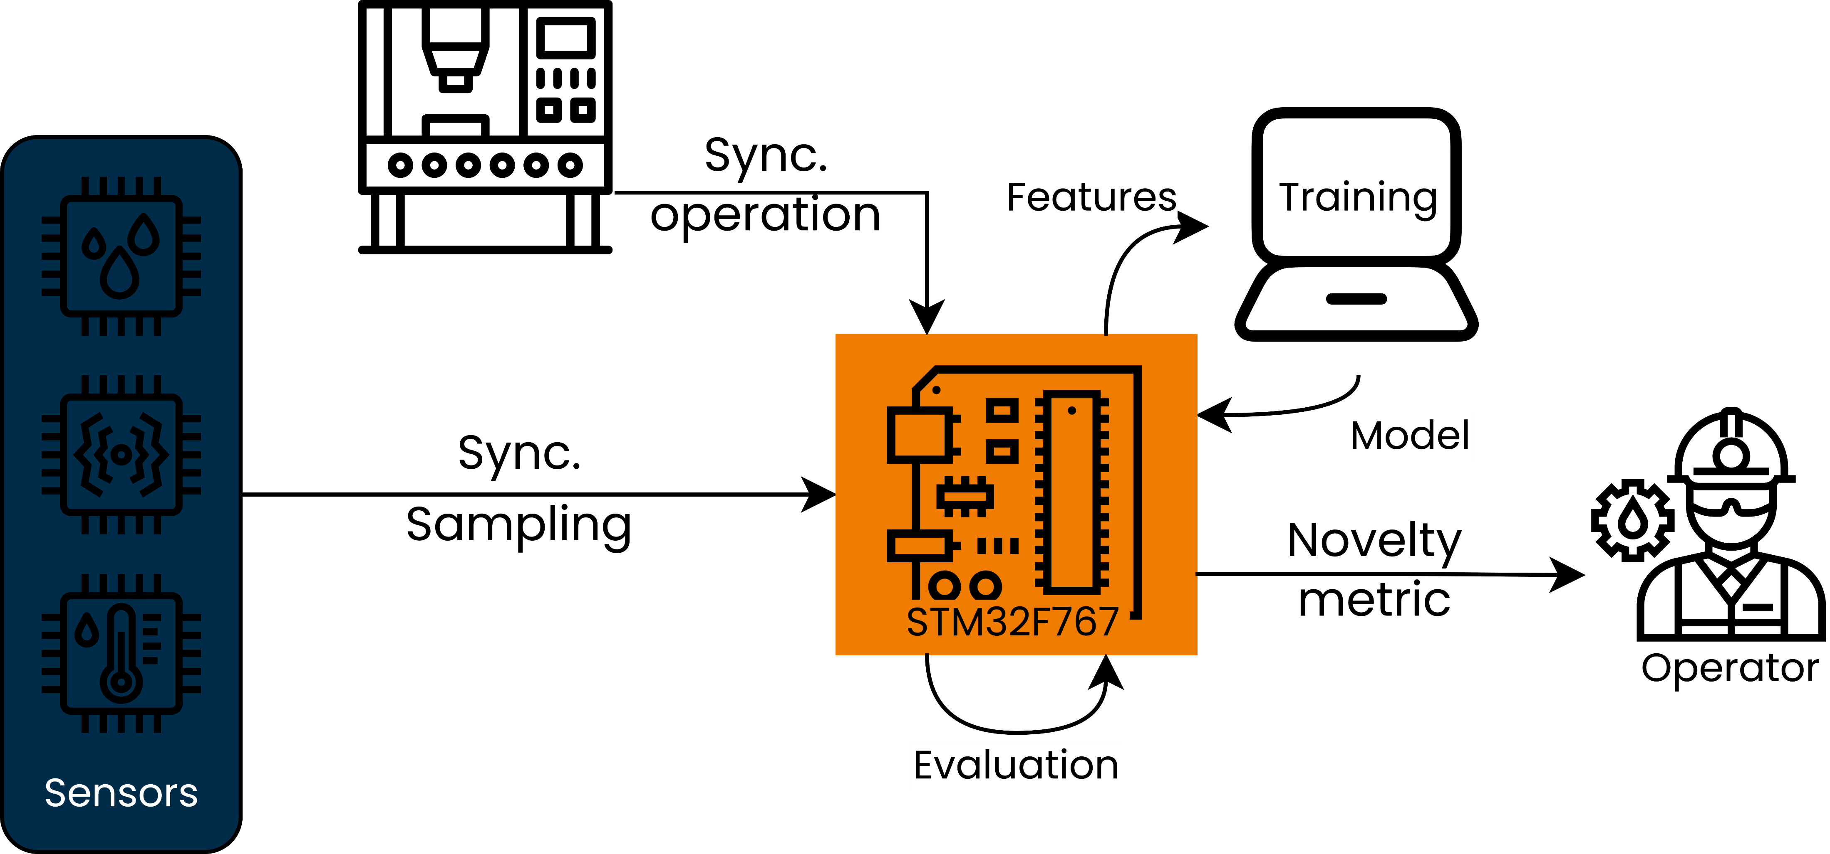
Embedded implementation

Slide 27
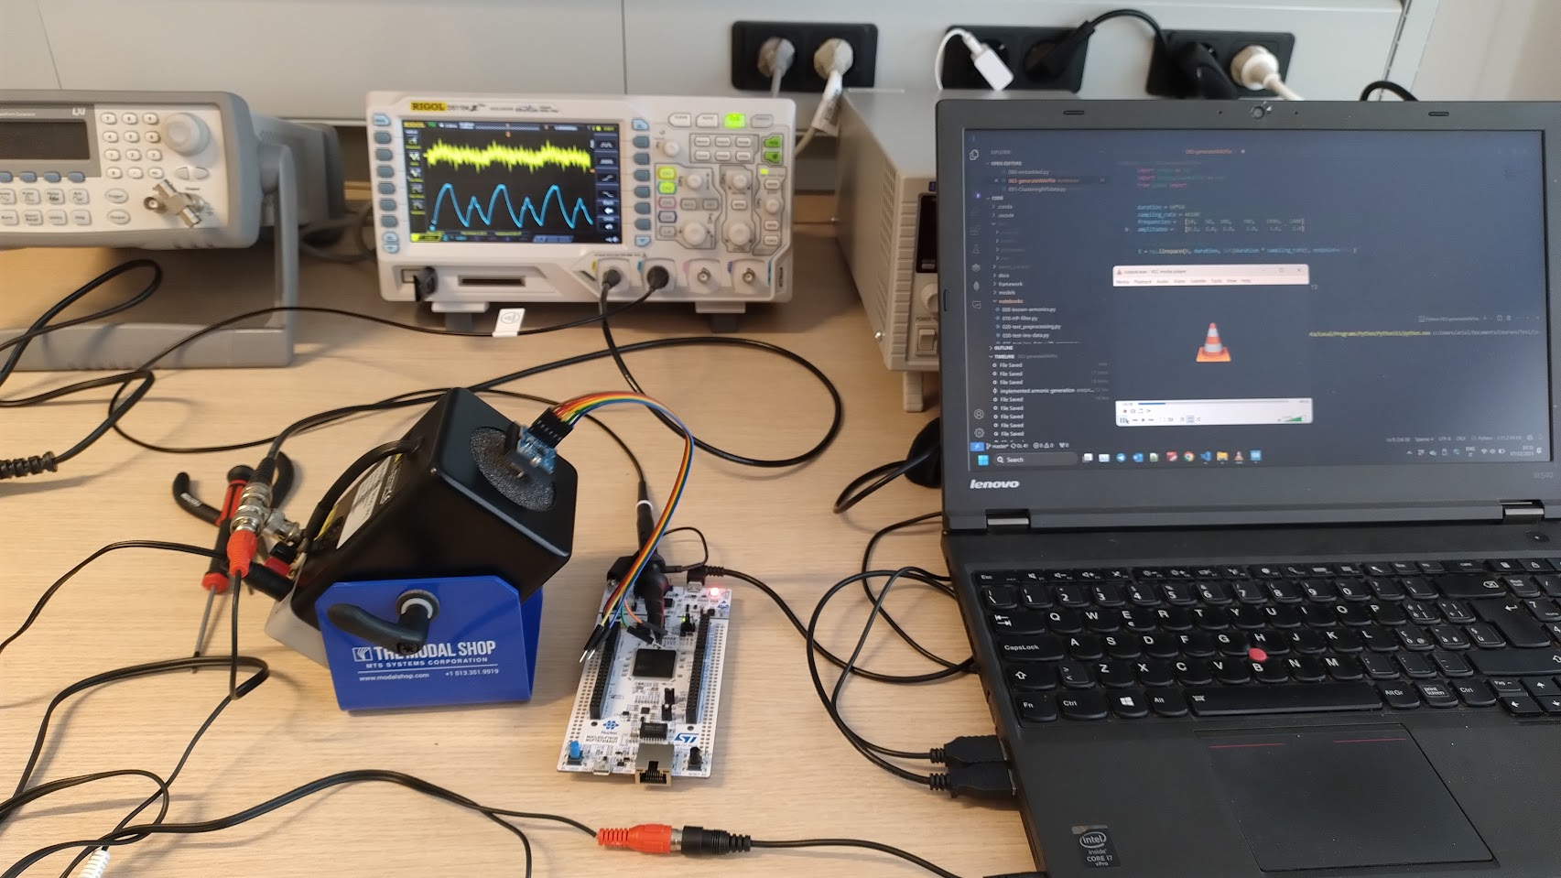
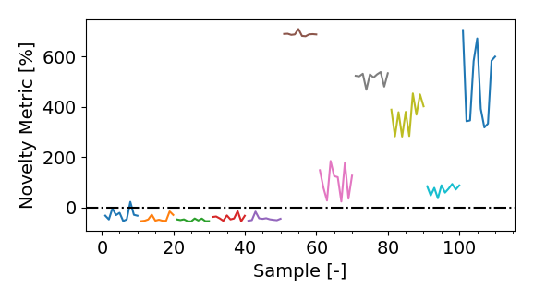
Embedded testing & future work
Laboratory tests:
Shaker
Linear actuator

Slide 28
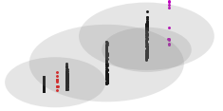
Embedded testing & future work
Laboratory tests:
Shaker
Linear actuator
Future work:
Implement LOF or iForest for embedded applications
Feature m
Feature n

Slide 29
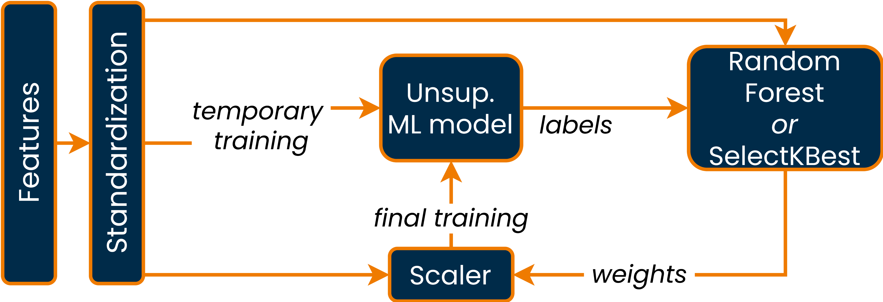
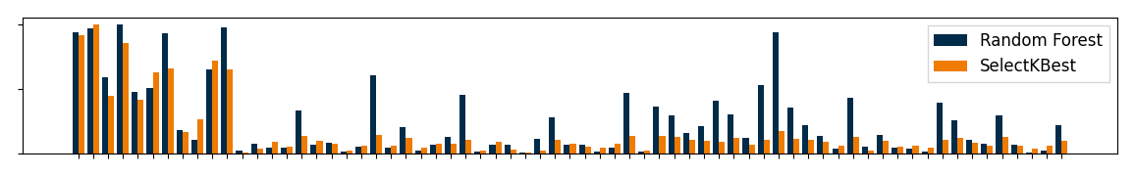
Feature Scaling
Weights
Features

Slide 30
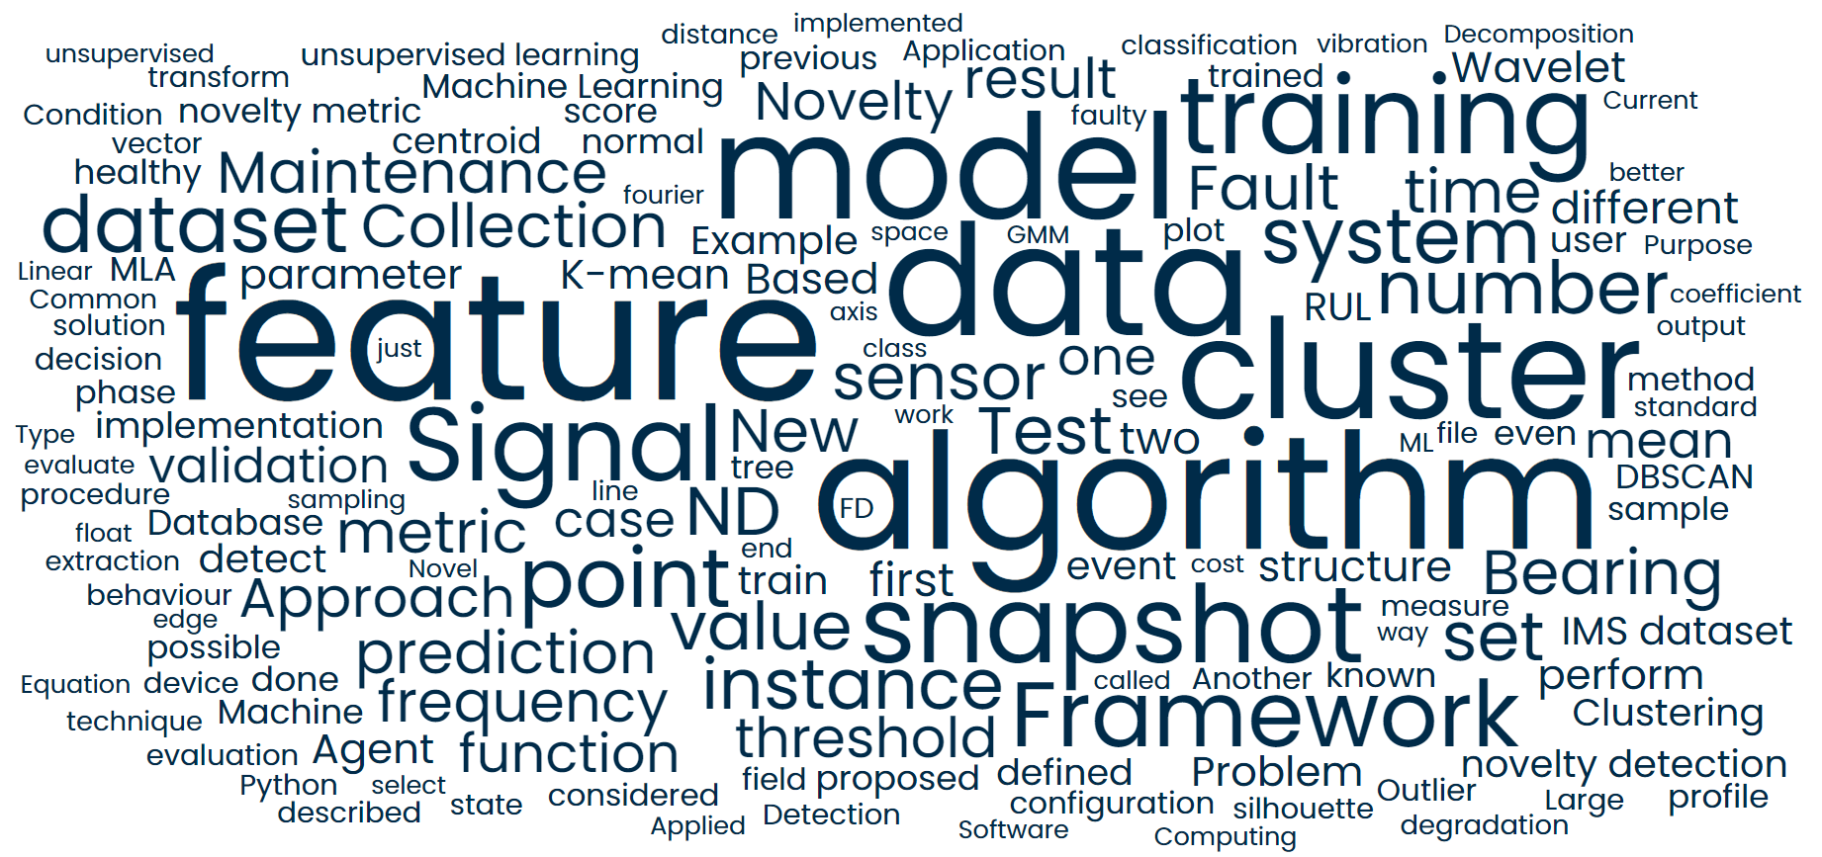
thanks for your attention

